Slide 1
Can Public Reason Accommodate Conscience?
Professor Brett G. Scharffs
Francis R. Kirkham Professor of Law Associate Dean of Research and Academic Affairs
Associate Director, International Center for Law and Religion Studies J. Reuben Clark Law School, Brigham Young University
Religious Freedom Discussion Series
September 4, 2013

Slide 2
Public Reason and Political Dialogue
Public reason as a framework for political dialogue has come to have a force in American and European political thought that might have come as a surprise even to its most articulate contemporary defender, John Rawls.
But as religious and other minority or dissenting voices are increasingly
pushed to the margins of public
discourse a serious philosophical,
political, and practical question has arisen about the extent to
which public reason can accommodate claims of conscience.

Slide 3
The Basic Problem
The basic problem can be presented starkly:
If public reason rules as inadmissible reasons that are not publicly accessible, is there any reason to respect conscience at all, since by its very nature the claims of conscience may be private and only partially accessible or explicable?
If public reason reigns supreme as a model of public discourse, are claims of conscience doomed?

Slide 4
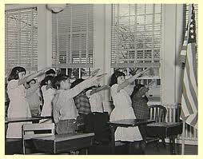
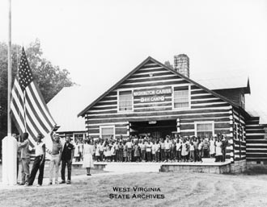
The Post World War II Pledge of Allegiance Cases
The high-water mark for the protection of conscience in U.S. Supreme Court jurisprudence may have come in the World War II - era Pledge of Allegiance case, West Virginia State Board of Education v. Barnette (1943).

Slide 5
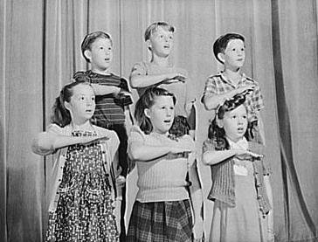
West Virginia v. Barnette: High-Water Mark
of Conscience Protection
In holding that patriotic observances must not be compulsory, the Court in West Virginia v. Barnett (1943) said, “We apply the limitations of the Constitution with no fear that freedom to be intellectually and spiritually diverse or even contrary will disintegrate the social organization.”
Freedom to differ, “is not limited to things
that do not matter much. That would be a
mere shadow of freedom. The test of its
substance is the right to differ as to things
that touch the heart of the existing order.”

Slide 6
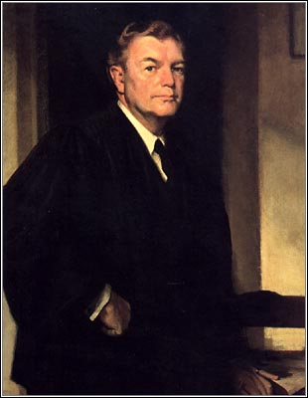
West Virginia v. Barnette: One of the Most Quoted Passages
in the Annals of Constitutional Law
Justice Jackson:
“If there is any fixed star in our constitutional constellation, it is that no official, high or petty, can prescribe what shall be orthodox in politics, nationalism, religion, or other matters of opinion or force citizens to confess by word or act their faith therein.”
West Virginia State Board of Education v. Barnette, 319 U.S. 624 (1943)

Slide 7
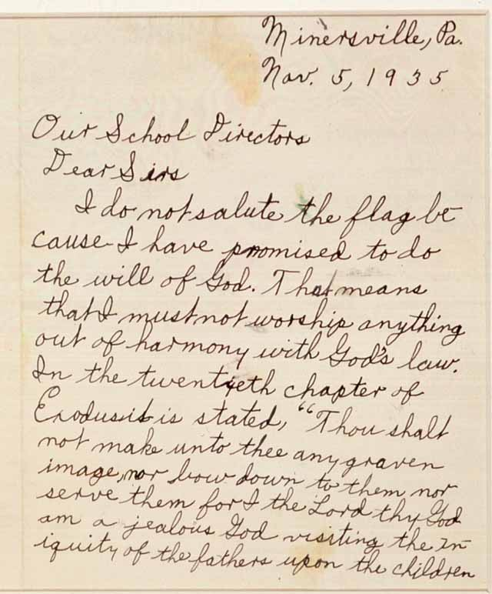
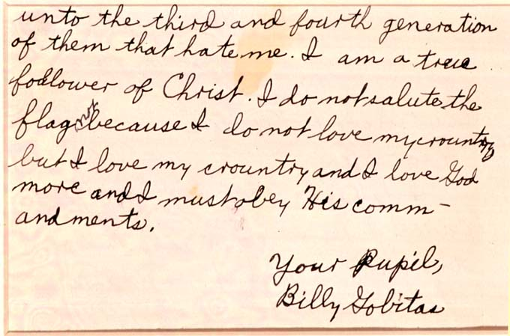
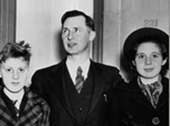
Minersville School District v. Gobitis
Only three years earlier, the Court had reached the opposite conclusion in Minersville School District v. Gobitis. By an 8–1 margin, the Supreme Court decided against the Jehovah’s Witnesses conscientious objectors and for the School District.

Slide 8
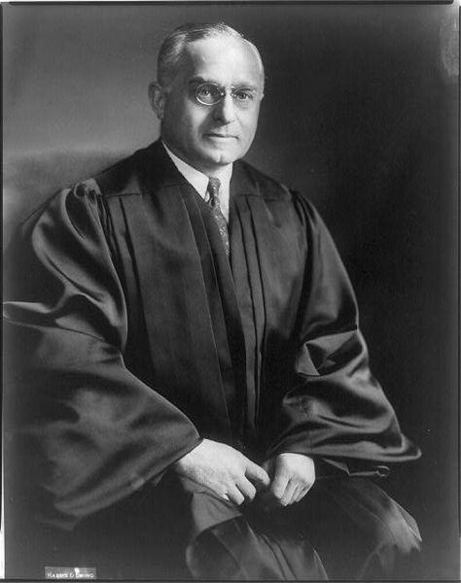
Justice Frankfurter in Gobitis (1940)
Citing the values of uniformity, patriotism, and equality to justify compelling students to participate in reciting the Pledge of Allegiance, Justice Felix Frankfurter wrote for the Court: “Conscientious scruples have not, in the course of the long struggle for religious toleration, relieved the individual from obedience to a general law not aimed at the promotion or restriction of religious beliefs. The mere possession of religious convictions which contradict the relevant concerns of a political society does not relieve the citizen from the discharge of political responsibilities. The necessity for this adjustment has again and again been recognized.”
Minersville School District v. Gobitis, 310 U.S. 586 (1940)

Slide 9
An Interest Inferior to None
Perhaps most significantly, Justice Frankfurter cited the importance of the values weighing against the Gobitis children’s free exercise and due process rights:
“We are dealing with an interest inferior to none in the hierarchy of legal values. National unity is the basis of national security.”

Slide 10
Barnette and Gobitis
Whereas Barnette may be our most eloquent defense of religious conscience, Gobitis is an equally unwavering plea on behalf of public reason, invoking values like national unity, national security, the inculcation of patriotism, equality, and the idea that religious scruples could not justify disobedience to a general law.

Slide 11
The Tenuous Status of Conscience Claims
The United States
Cases involving the Defense of Marriage Act and Proposition 8.
Christian club must accept all comers, not just as members, but as leaders, on the grounds that religious standards are discriminatory.
County clerks losing jobs due to refusal to perform same-sex marriages, even when other clerks in the same office could provide the service.
Religiously affiliated adoption clinics shutting down rather than submitting to demands to facilitate same-sex couple adoptions.
Pharmacists losing their jobs because of their conscience-based refusal to fill prescriptions for contraceptive or abortifacient drugs.
Employers being denied an exemption from Obamacare rules requiring their insurance plans to cover contraceptives and morning-after pills.
A wedding photographer being found in violation of antidiscrimination laws for declining to photograph a same-sex wedding.
Courts forcing an Amish girl to receive chemotherapy against her wishes.
Dartmouth College bishop being fired over his views on homosexuality.
Legislative proposal in California would deny tax exempt status to organizations such as Little League and the Boy Scouts, due to their allegedly discriminatory policies.

Slide 12
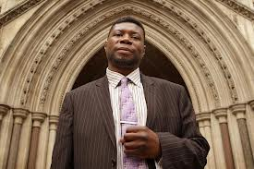
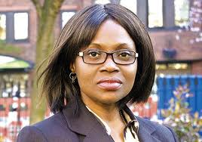
The Tenuous Status of Conscience Claims
Europe
In cases from England involving religious conscience, the European Court of Human Rights sends mixed signals:
upholding the right of a British Airways employee (Nadia Eweida) to wear a small cross at work,
but denying a similar right on grounds of hygiene and safety to a geriatrics nurse (Shirley Chaplin) who had worn a small crucifix necklace for thirty years,
upholding the dismissal of a therapist (Gary McFarlane) who objected to counseling same-sex couples,
and denying the claim of a marriage registrar (Lillian Ladele) who objected to conducting civil same-sex partnership ceremonies.
In Ireland, doctors being forced to provide abortions despite their conscientious objections.
Turkey admitting having secret identity codes for religious minorities.
Kazakh Baptists being fined for worship meetings.
Same-sex couples suing the Church of England for marriage rights.
In Russia, religious groups, texts, activities falling under the condemnation of new “extremism” laws.

Slide 13
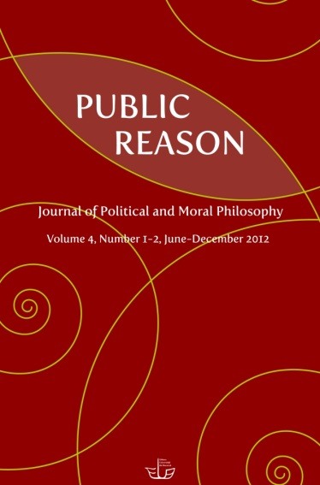
Public Reason
John Rawls
Kent Greenawalt
Bruce Ackerman

Slide 14
John Rawls: The Collective Reason of Equal Citizens
“To begin: in a democratic society public reason is the reason of equal citizens who, as a collective body, exercise final political and coercive power over one another in enacting laws and in amending their constitution.
In other words, political power is by its nature “coercive” and “final,” and when we as citizens exercise power over each other, we have an obligation – a moral obligation, an obligation of civility – to only exercise such coercive power pursuant to reasons that our fellow citizens can reasonably be expected to accept or endorse. In order for the exercise of political power to be legitimate in a liberal democracy, says Rawls, it must be exercised pursuant to the limitations imposed by public reason.
John Rawls

Slide 15
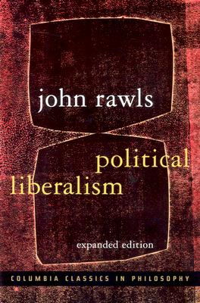
John Rawls: Political Conception of Justice
The content of public reason is based upon what Rawls calls a “political conception of justice” that is broadly liberal in character.
This political conception of justice has three features:
A specification of basic rights, liberties, and opportunities.
These rights, liberties and opportunities have a special priority as against teleological or general claims.
Citizens are empowered with the means of making effective use of these basic liberties.

Slide 16
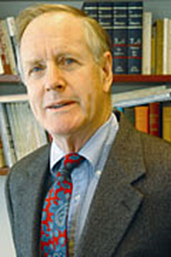
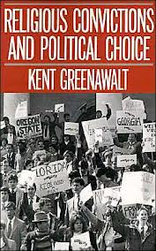
Kent Greenawalt: Shared Premises and Publicly Accessible Reasons
Columbia University law professor Kent Greenawalt explains the power and appeal of public reason in his book, Religious Convictions and Political Choice, where he identifies public reason as reason that rests on “shared premises and publicly accessible reasons.“ As Greenawalt explains, “The clearest instances of judgments based on publicly accessible reasons are ones based on reasons whose force, rather than being a product of the particular persons making the judgments, would be acknowledged by any competent and levelheaded observer. . . . “Religious morality and religiously grounded moral judgments” are “beyond shared premises and publicly accessible reasons.”
Kent Greenawalt

Slide 17
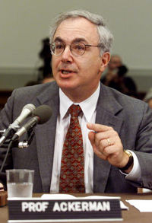
Bruce Ackerman: Maximal Exclusion Doctrine
Religion does not have an appropriate place in the public realm of a liberal democracy. The principles of justice result from a conversation among citizens, and for the conversation to yield determinate outcomes the permissible arguments must satisfy the condition of neutrality, which binds legitimate states to adopting a particular conception of equality, to toleration, and to individual rights.
The social contract is the contract that would be confirmed by the entire population, under ideal conditions, after perfect and complete consideration.
Bruce Ackerman

Slide 18
Critiques of Public Reason: The Problem of Insincerity
If we translate our “real” reasons into “public” reasons, there is doubt that we are being completely candid about why we believe what we advocate.
For example, when secular reasons are given in opposition to abortion rights or gay marriage, audiences (and especially opponents) question the sincerity of these reasons.
The “real” objection, they suspect, is religious; religious reasons, they contend, don’t count; and so the translated “secular” reasons are discounted, suspected, or treated as being disingenuous.
Giving our real reasons in public, this objection maintains, is what should count as “public reason,” not hiding them behind reasons that might be more secular.

Slide 19
Critiques of Public Reason: Public Reason and Persuasion
Another objection to public reason focuses on what are and are not legitimate forms of persuasion.
Rhetoric, as understood and defended by Aristotle, Cicero, and others, is subject to limitations in order for it to be legitimate.
In a democracy, if a reason is found persuasive to a majority of voters (or legislators), we might say it qualifies as a “public reason.” If something persuades the public, this argument goes, it is a public reason.
This is not to say that anything goes, but the limits that apply to moral rhetoric would apply, rather than a separate set of moral norms to govern “political discourse.”

Slide 20
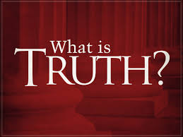
Critiques of Public Reason: Truth
A third objection is that reasons are legitimate if they are true. Rawls strenuously argues against the “whole truth” argument.
To say that reasons are not “publicly assessable” if they are not accepted by everyone who is reasonable, goes too far.

Slide 21
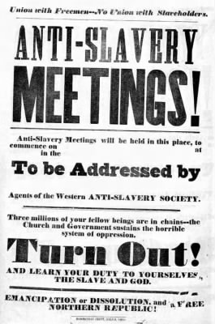
Selective Acceptance of Religious Reasons
One critique of public reason anticipated by Rawls is that much of the most important and persuasive political rhetoric in American history has been overtly religious, including the reasons of abolitionists who opposed slavery, and advocates of civil rights, such as Martin Luther King.

Slide 22
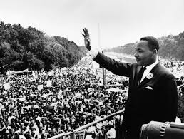
Selective Acceptance of Religious Reasons
Inclusive Public Reason
Rawls says that the overtly religious political rhetoric in American history does not violate public reason, because although the viewpoints may have been expressed in religious language, they could have been translated into more secular, neutral terms that comports with the standards of public reason.
Rawls concedes that abolitionists based their arguments on religious grounds; however, “the nonpublic reason of certain Christian churches supported the clear conclusions of public reason.”
The same, Rawls says, is true of Martin Luther King, who also made “public reason” arguments based upon Supreme Court cases such as Brown v. Board of Education – “to the political values expressed in the Constitution correctly understood.”

Slide 23
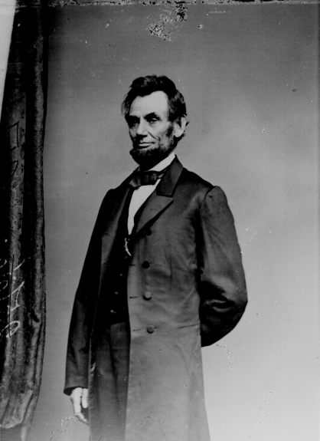
Selective Acceptance of Religious Reasons
Inclusive Public Reason
To cite another example, Abraham Lincoln in his second
inaugural address was not simply expressing political values
– freedom and equality for all – in terms of religious language,
his speech was a sincere meditation on God’s purposes in
allowing the Civil War to last so long and to exert such a toll
on both north and south.
Rawls argues for an “inclusive” attitude towards comprehensive doctrines (including religion), provided it is done in “ways that strengthen the ideal of public reason itself. “ But this argument is rather too convenient, and can easily degenerate into approbation of religious speech that aligns with one’s preferred political positions, and condemnation of religious speech that does not align with one’s preferred political positions.

Slide 24
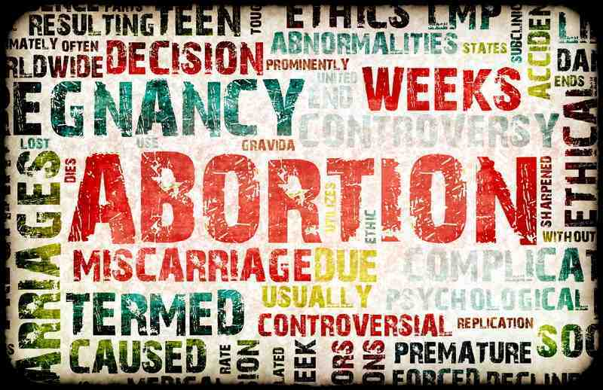
Selective Acceptance of Religious Reasons
Abortion
What Rawls has to say about abortion is instructive. He does not treat religious opposition to abortion as compatible with public reason, and seems to believe that efforts to translate opposition to abortion is either disingenuous or dishonest disguising of religious preferences.
He suggests that the question of abortion
implicates three important political values:
The due respect for human life.
The ordered reproduction of political society over time, including the family in some form.
The equality of women as equal citizens.
Rawls then asserts . . .

Slide 25
Selective Acceptance of Religious Reasons
“[A]ny reasonable balance of these three values will give a woman a duly qualified right to decide whether or not to end her pregnancy during the first trimester. . . . [A]t this early stage of pregnancy the political value of the equality of women is overriding, and this right is required to give it substance and force. Other political values, if tallied in, would not, I think, affect this conclusion. A reasonable balance may allow her such a right beyond this . . . . However, I do not discuss the question in general here, as I simply want to illustrate the point . . . that any comprehensive doctrine that leads to a balance of political values excluding that duly qualified right in the first trimester is to that extent unreasonable; and . . . it may also be cruel and oppressive; for example, if it denied the right altogether except in the case of rape and incest.”
Rawls concludes that denying abortion rights “would go against the ideal of public reason” and that any comprehensive policy that does not support first trimester abortion rights is unreasonable.

Slide 26
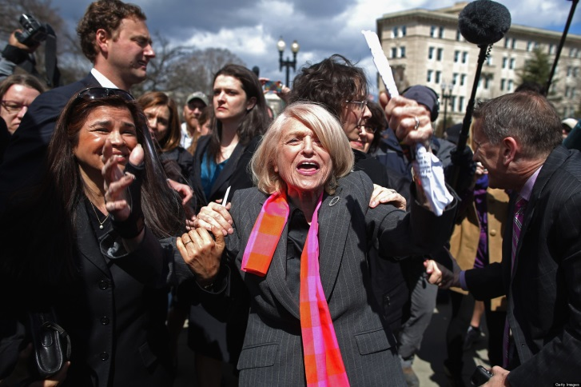
Selective Acceptance of Religious Reasons
The U.S. Supreme Court Marriage Decisions
Justice Anthony Kennedy’s Majority Opinion in Windsor
Justice Antonin Scalia’s Dissent in Windsor
Public Reason in the DOMA Case
In the June 26, 2013 decision in United States v. Windsor Justice Kennedy (joined by Justices Ginsburg, Breyer, Sotomayor, and Kagan) found that the definition of marriage as a union between one man and one woman in Section 3 of the Federal Defensive of Marriage Act (DOMA) is an unconstitutional violation of the Due Process Clause of the Fifth Amendment.

Slide 27
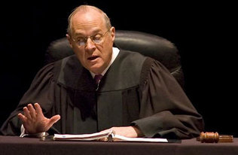
Justice Kennedy’s Majority Opinion in Windsor
Justice Kennedy begins the key section of his opinion (Part IV) with a broad declaration: “DOMA seeks to injure the very class New York seeks to protect.”
He goes on to say that the law was motivated by a “desire to harm a politically unpopular group” and suggests the law was motivated by an “improper animus or purpose.”
He says the “essence” of DOMA was to “interfere[] with the equal dignity of same sex marriages.”

Slide 28
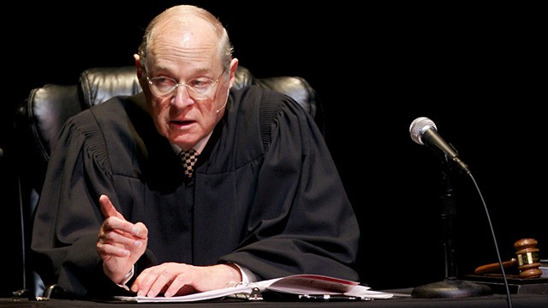
Justice Kennedy’s Majority Opinion in Windsor
Justice Kennedy cites with approval, and as his primary evidence of animus, language from the House report:
“The House concluded that DOMA expresses ‘both moral disapproval of homosexuality, and a moral conviction that heterosexuality better comports with traditional (especially Judeo-Christian) morality.”

Slide 29
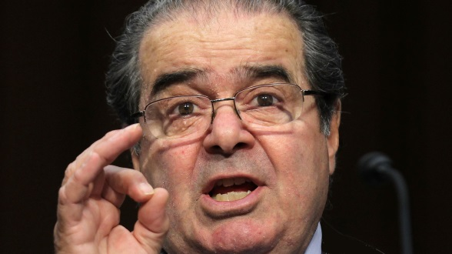
Justice Scalia’s Dissent in Windsor
Justice Scalia pulls no punches in his dissent, calling out the majority for its attribution of motives to the legislators (85 percent of the Senate and 84 percent of the House) and President (Bill Clinton) who enacted DOMA.
Complains Scalia,
“The majority says that the supporters of this Act acted with malice – the ‘purpose to disparage and to injure’ same-sex couples. It says that the motivation for DOMA was to ‘demean’; to ‘impose inequality’; to ‘impose . . . a stigma’; to deny people ‘equal dignity’; to brand gay people as ‘unworthy’; and to ‘humiliate’ their children.”

Slide 30
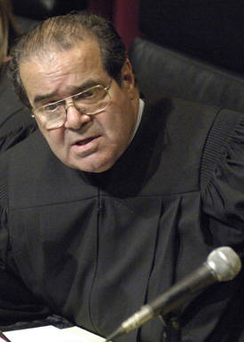
Justice Scalia’s Dissent in Windsor
Says Justice Scalia,
“To be sure (as the majority points out), the legislation is called the Defense of Marriage Act. But to defend traditional marriage is not to condemn, demean, or humiliate those who would prefer other arrangements, any more than to defend the Constitution of the United States is to condemn, demean, or humiliate other constitutions. To hurl such accusations so casually demeans this institution. In the majority’s judgment, any resistance to its holding is beyond the pale of reasoned disagreement.”

Slide 31
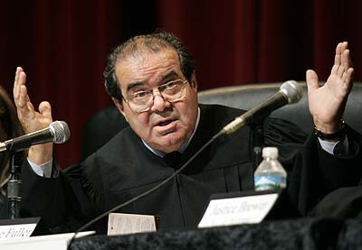
Justice Scalia’s Dissent in Windsor
“In the majority’s telling, this story is black-and-white: Hate your neighbor or come along with us. The truth is more complicated. It is hard to admit that one’s political opponents are not monsters, especially in a struggle like this one, and the challenge in the end proves more than today’s Court can handle. Too bad. A reminder that disagreement over something so fundamental as marriage can still be politically legitimate would have been a fit task for what in earlier times was called the judicial temperament.
We might have covered ourselves with honor
today, by promising all sides of this debate
that it was theirs to settle and that we would
respect their resolution. We might have let
the People decide.”

Slide 32
Public Reason in the DOMA Case
Smith is often cited as the most damaging judicial opinion of the last 50 years to religious freedom rights. Windsor may have an even stronger claim for its wholesale dismissal of religion.
Religious opposition to gay marriage is sweepingly dismissed as being motivated exclusively by “animus,” and all non-religious reasons are dismissed as being pretextual concealments of religious bias.
Not only are religious reasons comprehensively dismissed; expressing such opposition in terms of public reason is completely dismissed as well. Religious conscience is dismissed as nothing more than illegitimate animus.

Slide 33
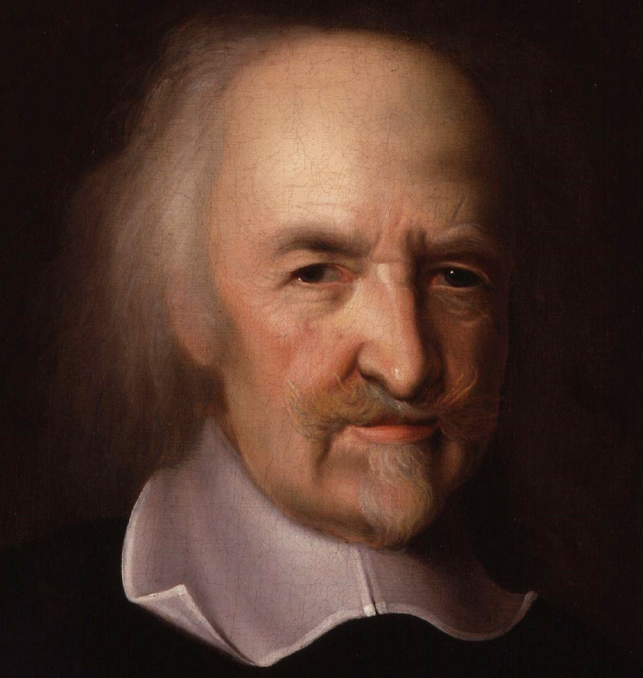
Thomas Hobbes and the Idea of Public Reason
In understanding the trajectory of the role of public reason in political discourse, and the prospects for claims of conscience surviving in a political culture in which public reason is the dominant conception of acceptable political and legal reasoning, it is helpful to understand something about the genesis of the idea of public reason, and the stark clarity with which its implications for conscience were originally understood.

Slide 34
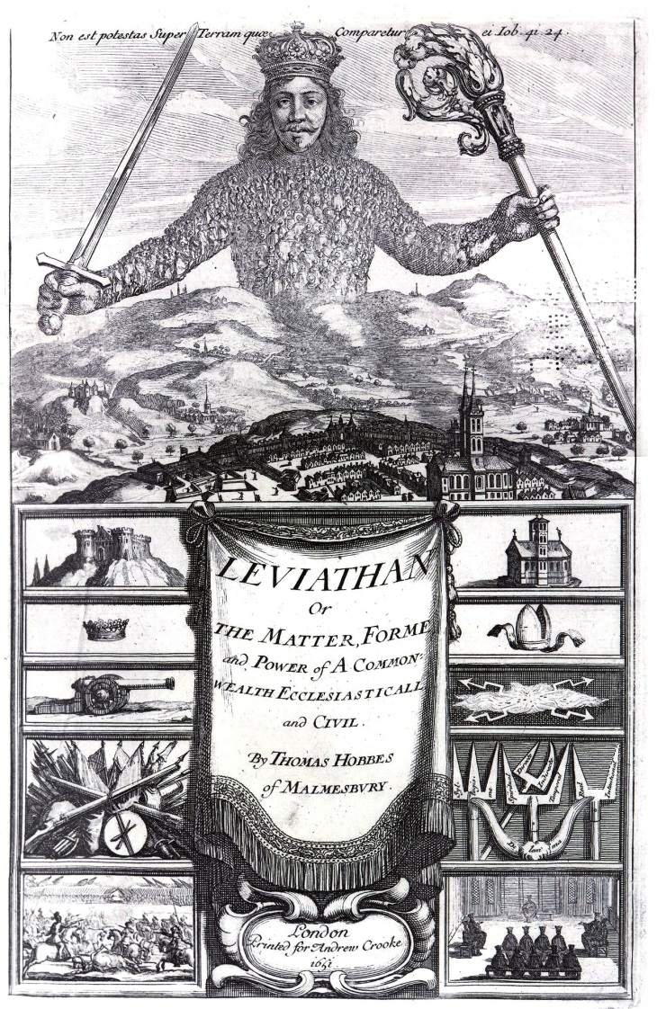
Thomas Hobbes and the Idea of Public Reason
The concept of public reason was not invented by Rawls, or even Immanuel Kant (to whom it is often traced, including by Rawls). It was Thomas Hobbes, writing a hundred years before Kant, in Leviathan, who introduced the idea.
As Kant did a century later, Hobbes contrasted public reason with “private reason,” which was identified with claims of conscience.
For Hobbes, public reason was the will of the sovereign (and nothing more): It was the reason given by the King or Parliament (representing the public), as opposed to reasons given by subjects (private reasons).

Slide 35
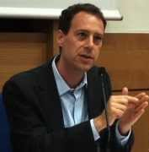
Hobbes’s Response to Puritan Rhetoric of Conscience
As Yale Political Science Professor Bryan Garsten has explained, Hobbes wrote in large measure in response to the “Puritan rhetoric of conscience,”
the defense of “private judgment” and conscience” that were “the regular form of public preaching among the Puritan ministers so important to seventeenth-century politics in England.”
These Puritan preachers asserted that such claims of conscience were inviolable, even if public authority demanded otherwise. Hobbes viewed such appeals as subversive and likely to be used to incite sedition. For Hobbes, claims of conscience were no more than private judgments that were seeking special status.

Slide 36
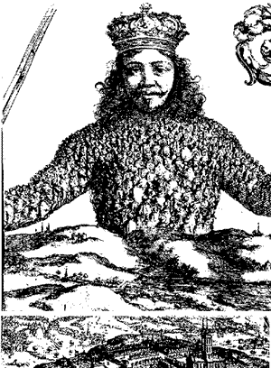
Hobbes’s Social Contract Theory
In Hobbes’s understanding of the state, individuals agreed to be governed by the Sovereign as a way of escaping the state of nature (the “war of all against all”), where life, in his memorable description, is “solitary, poor, nasty, brutish, and short.” Following the dictates of the omnicompetent sovereign, for Hobbes, vindicated conscience, since the individual had already consented to submit to political authority.
As Professor Garsten explains, “a person who followed the
Laws in a Hobbesian commonwealth was by definition acting
according to the dictates of conscience, since he had
transferred the right of determining ‘the public conscience’
to the sovereign: [in the words of Hobbes,] ‘The law is the
public Conscience.’” The obligation to obey the sovereign lasts as long as the sovereign protects his subjects.

Slide 37
Hobbes on Conscience
As Hobbes put it: “The conscience being nothing else but a man’s settled judgment and opinion, when he hath once transferred his right of judging to another, that which shall be commanded, is no less his judgment, than the judgment of that other; so that in obedience to laws, a man doth still according to his conscience, but not his private conscience. And whatsoever is done contrary to private conscience, is then a sin, when the laws have left him to his own liberty, and never else.”
For Hobbes, it was no sin to act contrary to conscience, provided this was at the direction of the sovereign. Ceding conscience to the sovereign in matters of public important also shields individuals from the preaching and prophesizing of those who claim to speak on behalf of God.

Slide 38
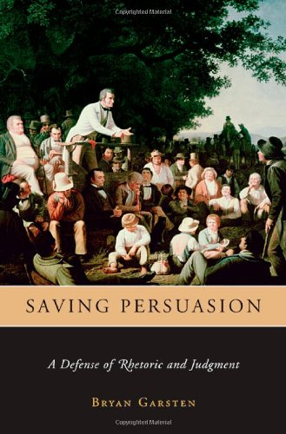
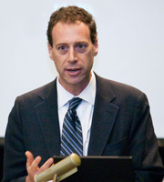
Bryan Garsten on Hobbes
“We have seen that when Hobbes devised his understanding of
representation, he was asking citizens to disregard not only their
own judgments and dictates of conscience but also, and perhaps
more importantly, those judgments supplied to them by preachers
and prophesiers. He asked citizens to protect themselves from
the influence of these orators by chaining their ears to the lips
of the sovereign, whose words he called the ‘public conscience’
and, in Chapter 37 of Leviathan, the ‘public reason.’ For the sake of peace, he argued, ‘the Private Reason must submit to the Publique.’ Public reason was thus created as a means of avoiding controversy by providing an external source of
unified judgment. It sought to avoid the political tumult that resulted
when each citizen was left to judge for himself and thus made prey
to the influence of orators.”
Bryan Garsten – Saving Persuasion: A Defense of Rhetoric and Judgment

Slide 39
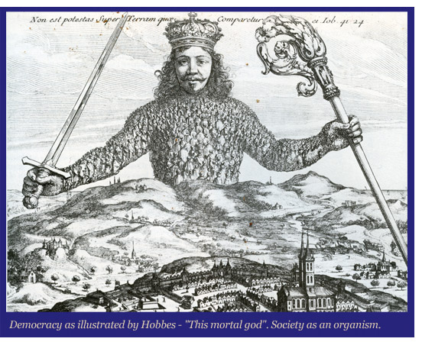
Hobbes on the Diseases of the Commonwealth
Hobbes warns against the “diseases of a commonwealth that proceed from the poison of seditious doctrine, whereof one is that every private man is judge of good and evil actions.”
This may be true in the state of nature, but not in a commonwealth, where “the measure of good and evil actions is the civil law, and the judge the legislator, who is always representative of the commonwealth.”

Slide 40
Rawls on Aristocratic and Autocratic Regimes
We would expect a Rawlsian liberal to object strongly to their understanding of public reason being linked with Hobbes’ sovereign Leviathan.
Indeed, Rawls expressly denies that “aristocratic and autocratic regimes” exhibit public reason, because in such regimes it is “rulers” that consider the public good, if it is considered at all.

Slide 41
Rawls on Public Reason and Democracy
Declares Rawls, “Public reason is characteristic of a democratic people: it is the reason of its citizens, of those sharing the status of equal citizenship. The subject of their reason is the good of the public: what the political conception of justice requires of society’s base structure of institutions, and the purposes and ends they are to serve.”

Slide 42
Rawls on Freedom of Conscience from Authority of the State
But for Rawls, there are no analogous rights of freedom of conscience from the authority of the state short of renouncing one’s citizenship.
As Rawls explains, in contrast with religious groups, where you can evade the institution’s authority, by withdrawing, “the government’s authority cannot be evaded except by leaving the territory over which it governs, and not always then.”
Thus, if the state insists on forcing us to act in violation of our conscience, our options are limited – we can emigrate (and even that may not put us beyond the reach of the state’s jurisdiction).

Slide 43
Free Exercise and Protecting Religious Conscience:
The Compelling State Interest Test
In the post-World War II years, the Supreme Court developed a test for assessing free exercise claims known as the compelling state interest test.
When religion was burdened, there was a presumption that this was a violation of free exercise rights unless the state could prove that the limitation of freedom was justified by a compelling state interest and was achieved by the least restrictive means.

Slide 44
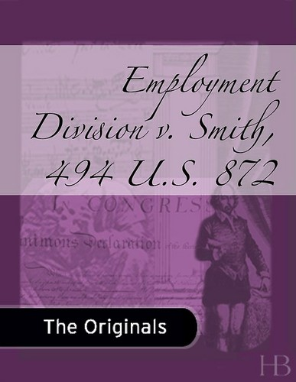
Free Exercise and Public Reason: General and Neutral Laws
But as is well known, the situation changed dramatically with the Court’s decision in Employment Division v. Smith (1990), which involved a conscientious objection claim for religious uses of the hallucinogenic drug peyote when ingested in Native American Church religious ceremonies.
In Smith the Supreme Court articulated a new test for free exercise claims. A state law that burdens religious exercise does not violate the Free Exercise Clause as long as that burden is imposed through a general and neutral law.

Slide 45
The Central Question
Can (and must) public reason respect claims of conscience?
On one level the answer is clearly, “yes.”
Political majorities, for reasons recognized by public reason, might agree to protect or accommodate conscience, including the conscience of minorities.
Thus, for example, U.S. law has included provisions protecting conscientious objectors to military service.
The question of whether public reason must (or can be expected) to accommodate conscience is much more problematic.

Slide 46
The Central Question: Public Reason Two-Step
Consider the basic form of reasoning that might fail to protect conscience:
first, coercive legislation should be based upon public reasons;
second, private reasons (such as religious convictions) do not count as public reasons and can therefore be discounted.
This is what we might call the “public reason two-step.”
This is not just a description of public reason as envisioned by Thomas Hobbes. Every conception of public reason – whether that of Hobbes, Kant, or Rawls – begins by differentiating between public reason and private reason, and by crediting the former and discrediting the latter. Thus, unless claims of conscience can be expressed persuasively in terms of public reason, they may not only be discounted, they may be disclaimed as illegitimate.

Slide 47
Effective v. Ineffective Dissent
Yale Law Professor Stephen L. Carter
[Thanks to Galen Fletcher of our BYU Law Library for bringing Carter’s argument to my attention.]
Carter notes that the government is much more protective of speech when it is unconnected with action, and when it is made ineffectively by individuals than when it is made effectively by institutions (such as religions). In a lecture given at Harvard in May 1995, Carter described the attitude about governmental limits on religion as follows:

Slide 48
Stephen Carter: Effective v. Ineffective Dissent
“Preach whatever you like, as long as you are unconvincing. . . . But if you are preaching about something serious, and if you begin to persuade others to act, why, then the state may stop you. And there lies the point: by protecting advocacy only until it moves people to act, the courts have drawn not simply a speech/action distinction, but an individual/group distinction. The lone critic is no danger, because he can do nothing alone. But the group, because it is better able to act, becomes a threat. That is why those in power have always sought legal means to thwart organizations that are preaching dissent; while leaving ineffective individuals largely alone. This allows us to proclaim a respect for free speech, leaving unspoken the corollary, that speech will be left free only as long as it is ineffective.”

Slide 49
Conclusion
Where does a strong commitment to public reason lead?
We have reason to worry that it may lead to the Liberal Leviathan – the tyranny not of Hobbes’s imperial sovereign, but the tyranny of imperious majorities (or perhaps overbearing judges), confident (even self-righteous) in the reasonableness of their own views, and with every reason (in their minds) to disparage and disregard claims of conscience by those who would dissent; such claims of conscience being ipso facto “unreasonable” because they do not satisfy the conditions of public reason.

Slide 50
Conclusion
In dividing “reason” into “public reason” and “private reason,” and by treating the one as legitimate and the other as illegitimate, and by placing comprehensive religious systems of belief into the category of “private reasons,” public reason clears away the unruly underbrush of conscience in the service of building the shiny edifice of the Liberal Leviathan.

Slide 51
Can Public Reason Accommodate Conscience?
Professor Brett G. Scharffs
Francis R. Kirkham Professor of Law Associate Dean of Research and Academic Affairs
Associate Director, International Center for Law and Religion Studies J. Reuben Clark Law School, Brigham Young University
Religious Freedom Discussion Series
September 4, 2013

